Slide 1
Blockchain-powered Certificate Authentication: A Decentralized Approach with IPFS Integration.

Slide 2
Introduction :
Implementation of Decentralized Certificate Verification and Validation System on Public Blockchain .
Utilize public blockchain to create secure, transparent, and tamper-proof result management system, addressing data manipulation and cyber threat issues.
This solution lowers the possibility of fraud, improves accessibility worldwide, and guarantees tamper-proof academic records by utilizing the transparency, immutability, and security properties of a public blockchain.

Slide 3
Motivation:
The project is motivated by the need to address the limitations of centralized result management systems in educational institutions.
These systems are prone to data manipulation, lack transparency, and are vulnerable to cyber threats.
The project's goal is to guarantee data integrity, improve transparency, and offer a safe platform for handling academic outcomes by utilizing public blockchain technology.

Slide 4
Future Scope:
Enhanced Authenticity and Security: By leveraging the decentralized storage of IPFS and the immutable ledger of blockchain, certificates are made to be impervious to tampering and easily verifiable. By doing this, fraud can be greatly decreased and confidence in digital credentials can rise.
Interoperability and Integration: Widespread adoption might be aided by the development of APIs and frameworks that permit smooth integration with current professional and educational systems. The value and scalability of the solution can be further improved by interoperability with other blockchain-based systems.

Slide 5
Privacy and Control: Because IPFS and blockchain are decentralized, users can share only the essential information with other parties, giving them more control over their personal data and in line with the growing number of data privacy laws and user preferences
Cost-effectiveness: Blockchain-powered certificate authentication can cut operating expenses for credentialing organizations and educational institutions by doing away with the need for middlemen and manual verification procedures.
Long-term Data Integrity: By preserving certificates and related data indefinitely through IPFS's content-addressable storage, long-term accessibility and dependability are ensured without the need for centralized servers.

Slide 6
Literature survey:
Throughout our survey, we encountered several recurring themes and noteworthy findings. The literature predominantly focuses on P2P networks, Block mining, Smart contracts, indicating the significance of these aspects within the field of Blockchain. Researchers have emphasized Result management, Smart contracts, Data privacy, Data verification and have highlighted the challenges related to centralized result management. Literature Review on Decentralized result management system using blockchain:
Project_Literature_review.xlsx

Slide 7
Problem statement:
Develop a blockchain-based certificate verification system utilizing public blockchain for secure and transparent validation of certificates, ensuring authenticity and preventing tampering, with user-friendly interfaces for issuance and verification.
Utilize public blockchain to create secure, transparent, and tamper-proof result management system, addressing data manipulation and cyber threat issues.

Slide 8
Objectives :
To understand the need for decentralized certificate verification and validation systems.
Design a public blockchain-based result management system ensuring data integrity and security.
Develop smart contracts for automating result processes. Evaluate feasibility of migrating centralized systems to decentralized blockchain solution.
To discuss the coding and implementation aspects of decentralized certificate systems on a public blockchain.

Slide 9
Coding and Implementation :
Overview of the coding and implementation process for decentralized certificate systems:
User interface development
Backend integration
Smart contract development
Blockchain integration
Certificate verification process
Security considerations
Testing and deployment
Maintenance and upgrades

Slide 10
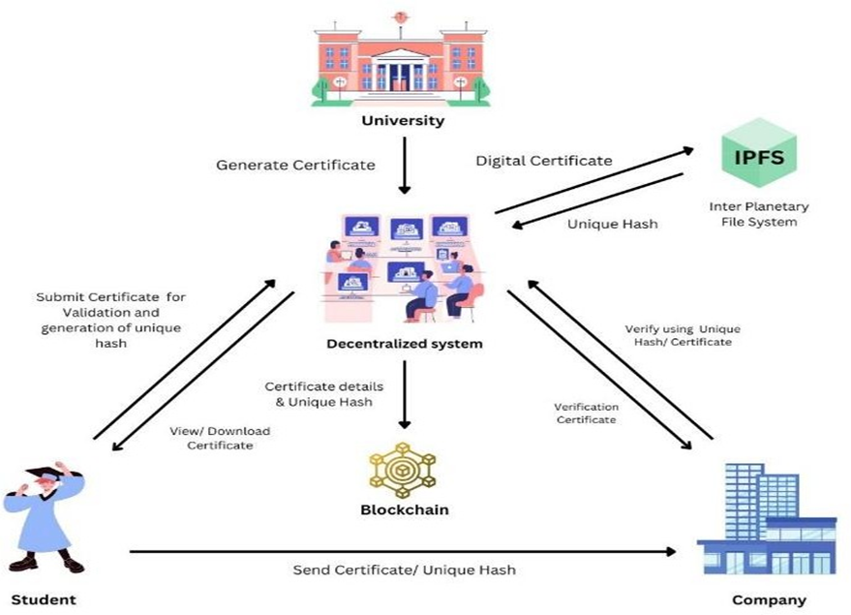
Architecture diagram:

Slide 11
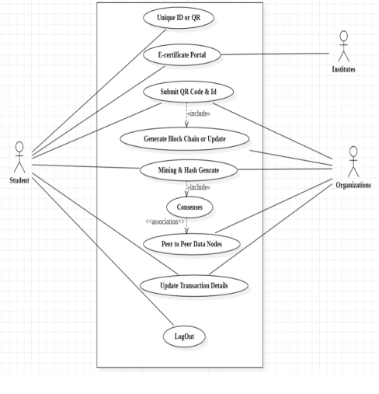
Use-case diagram:

Slide 12
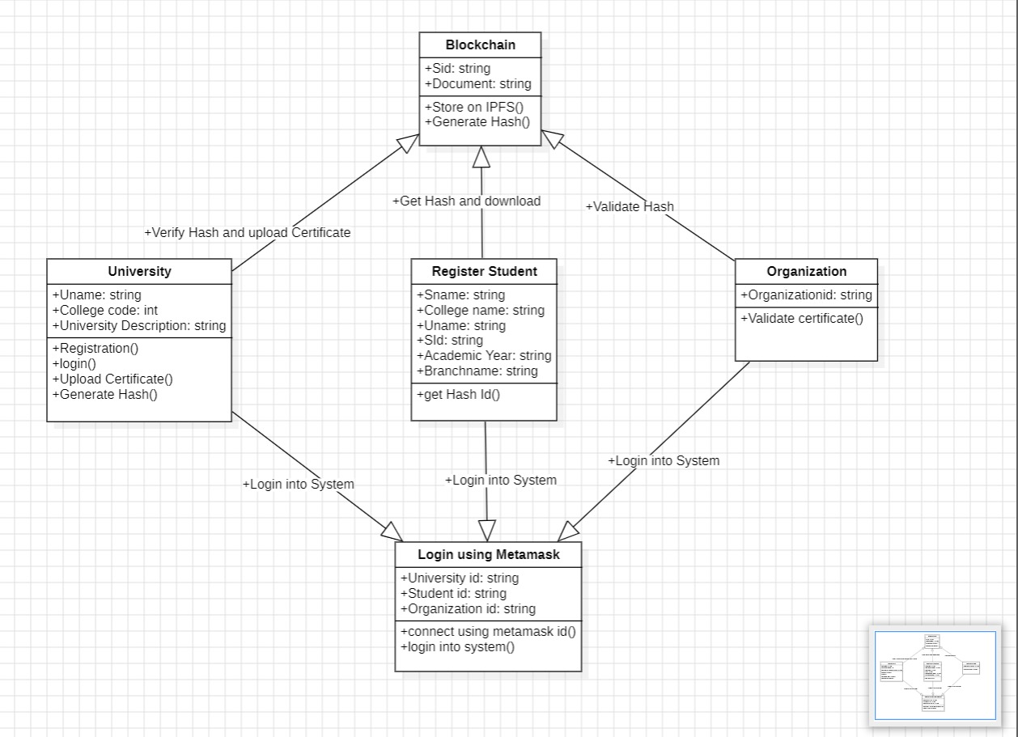
Class diagram:

Slide 13
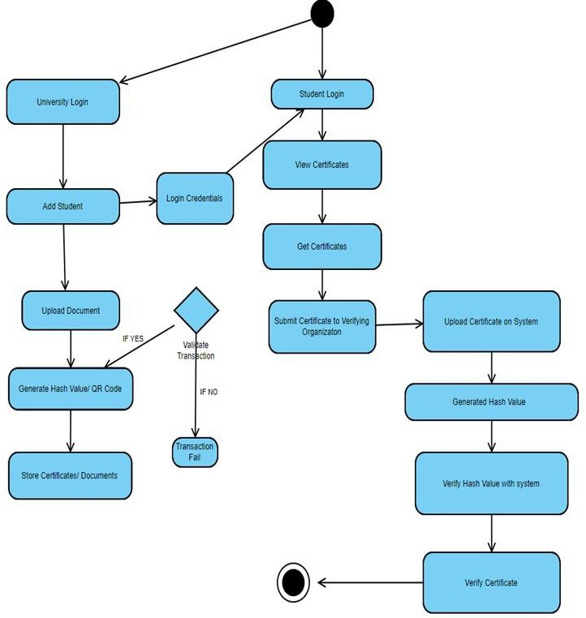
Activity diagram:

Slide 14
Algorithm:
Start
Upload student record, add necessary information.
If record already exist then go to step 8, Else; print “Upload Successful.”
Store certificate in IPFS.
Generation of hash code.
Preview certificate.
Validate certificate.
Download certificate.

Slide 15
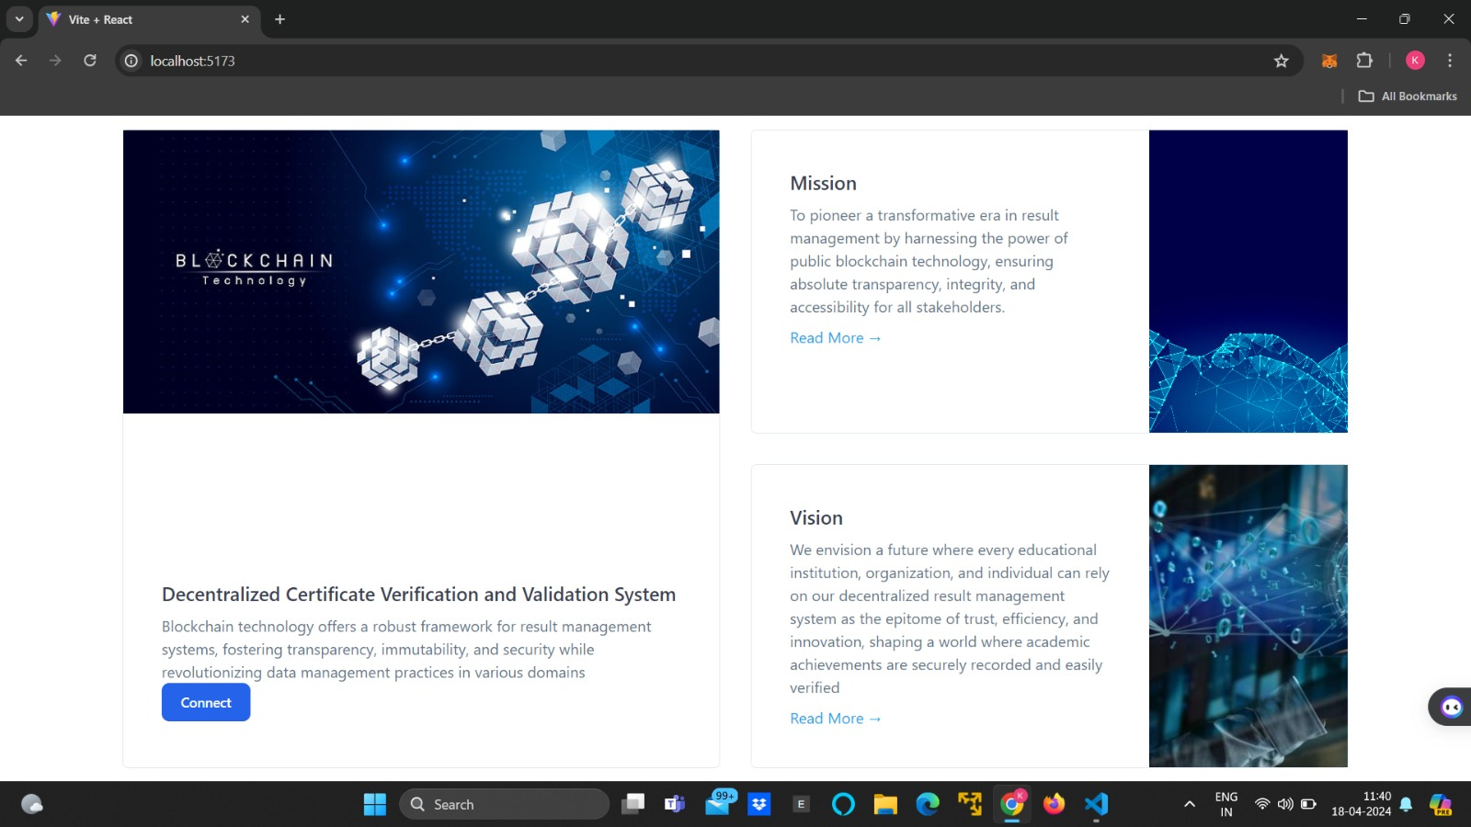
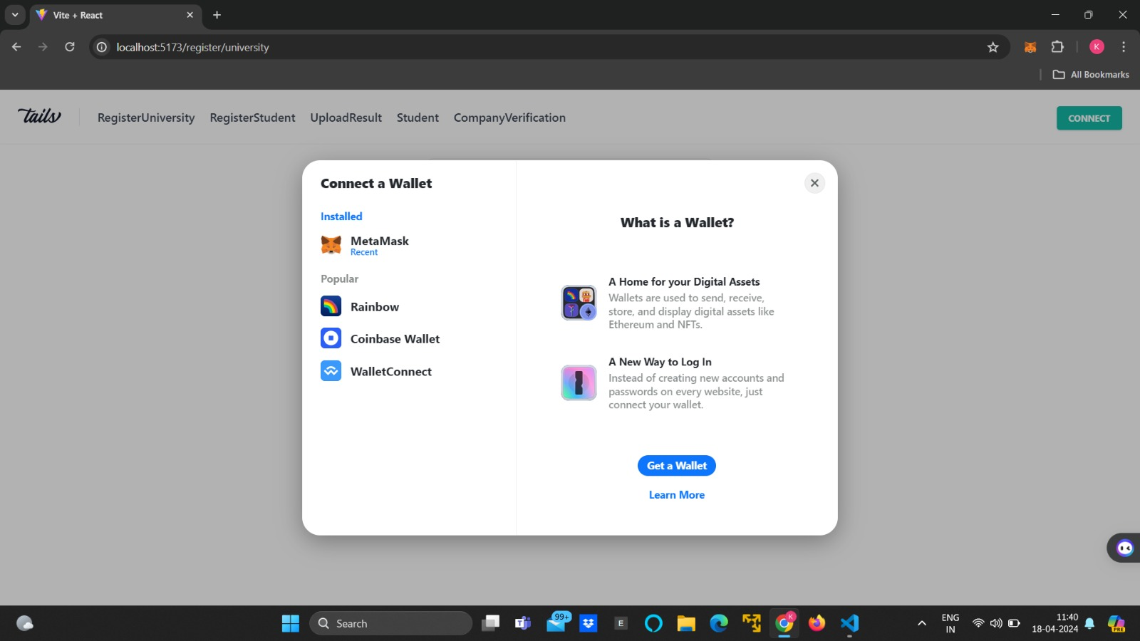
Result:

Slide 16
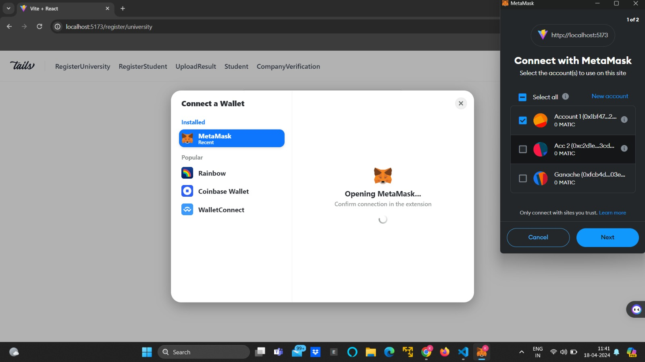
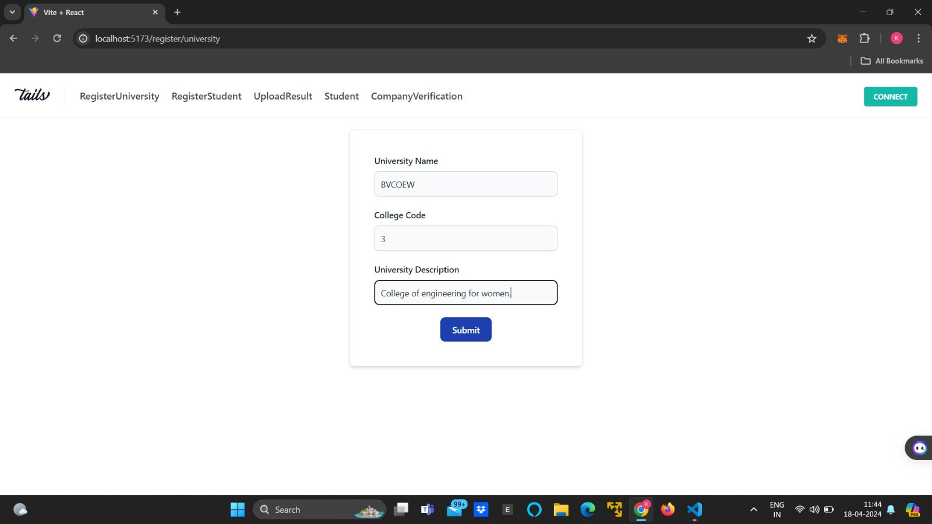

Slide 17
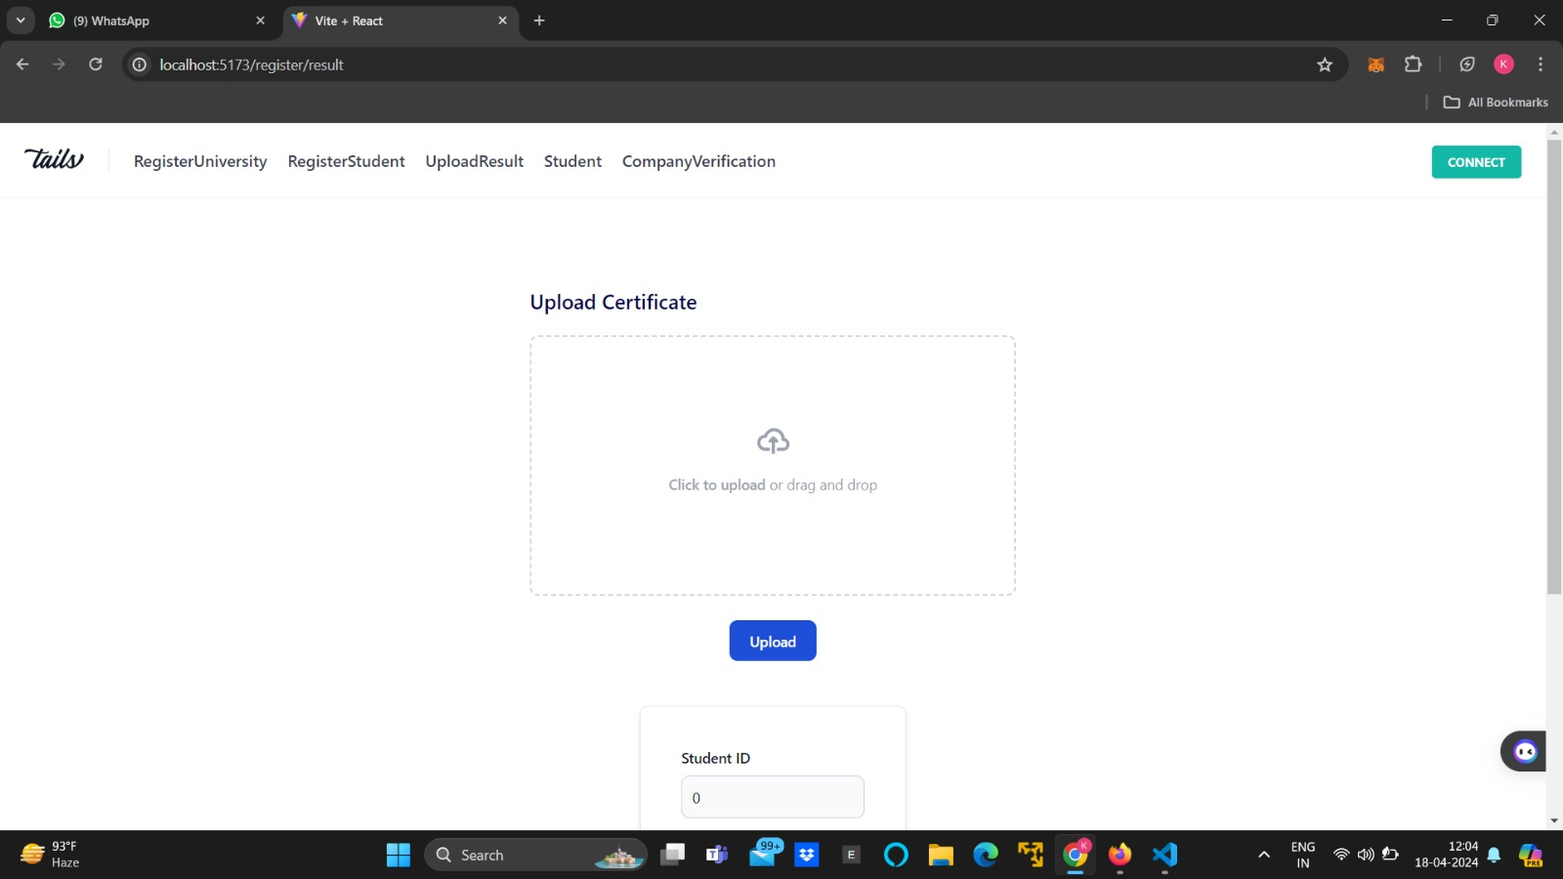
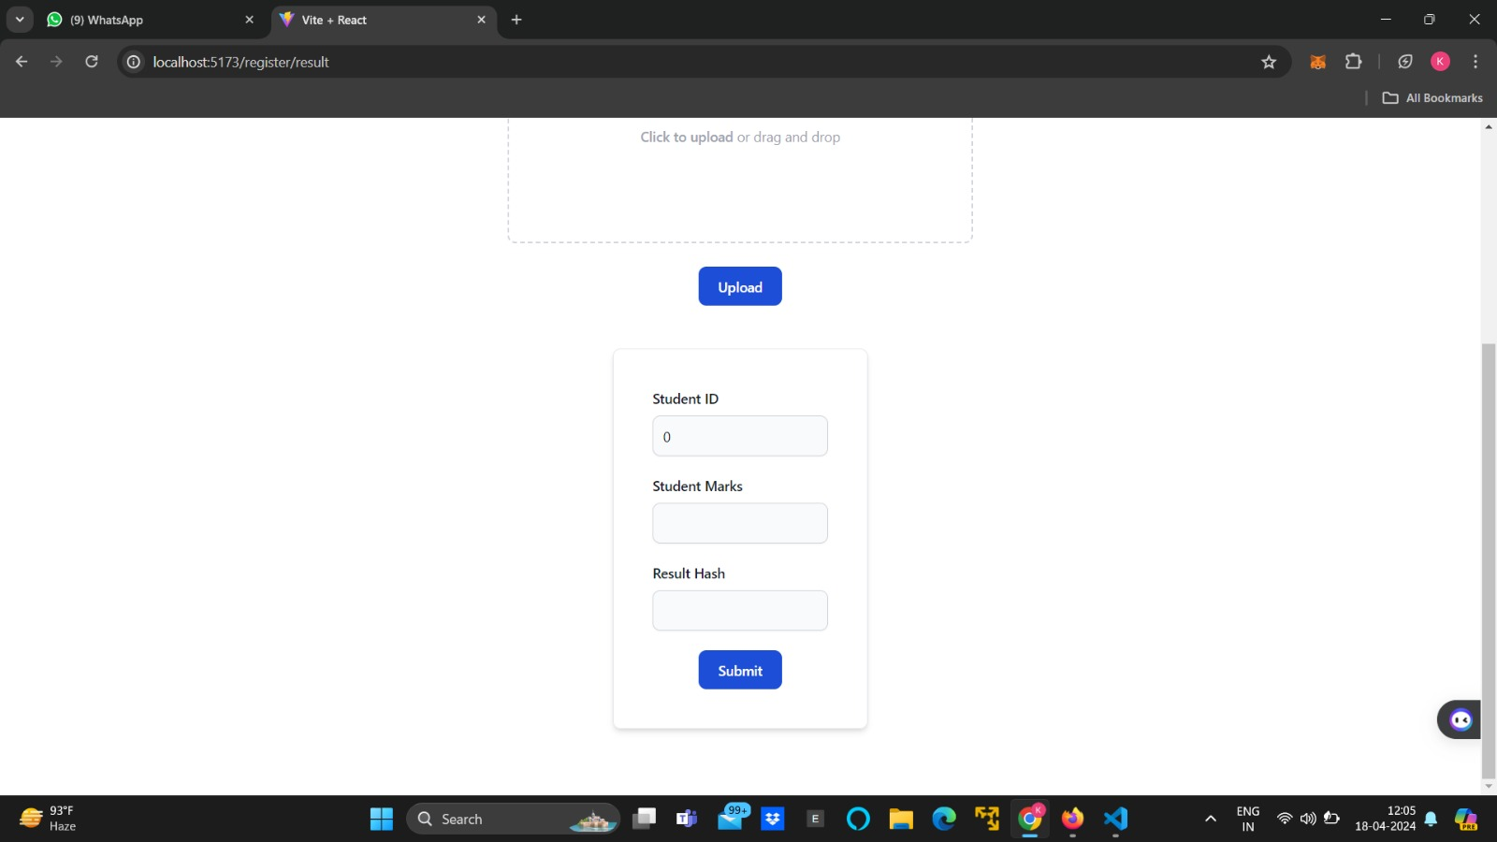

Slide 18
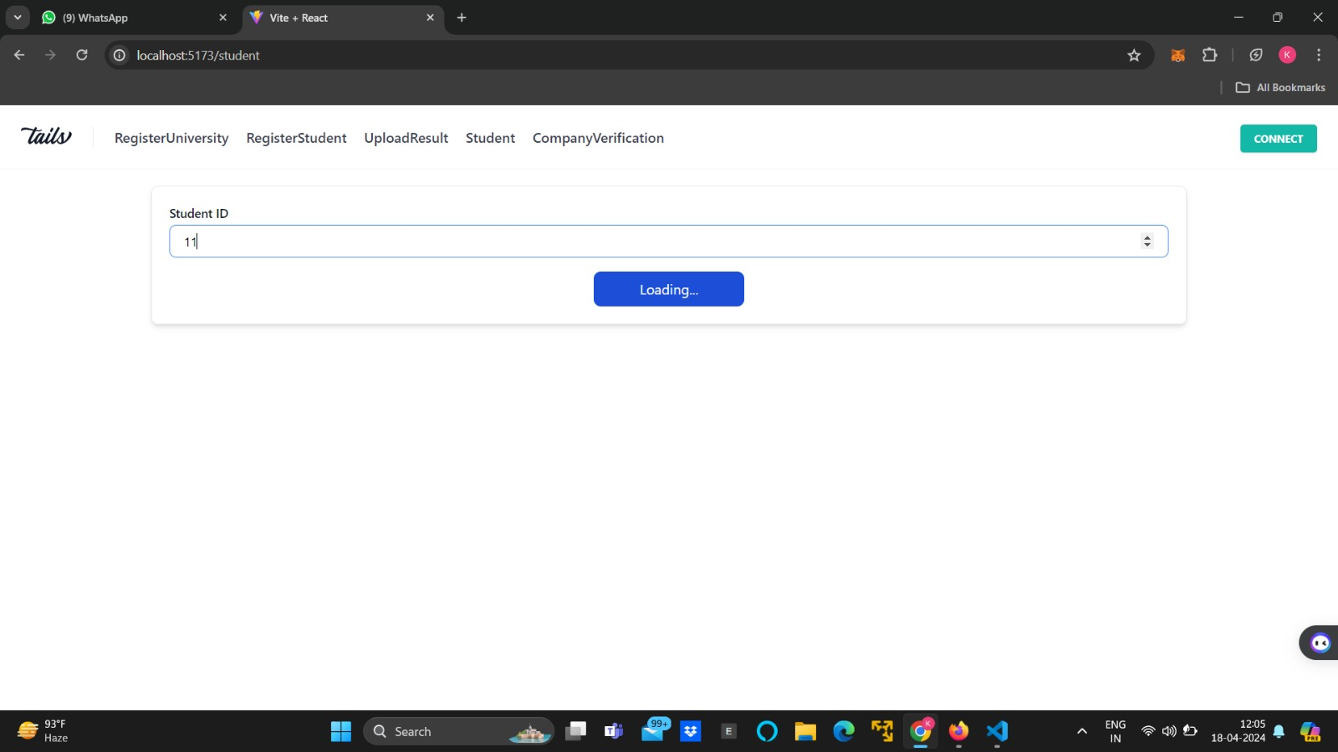
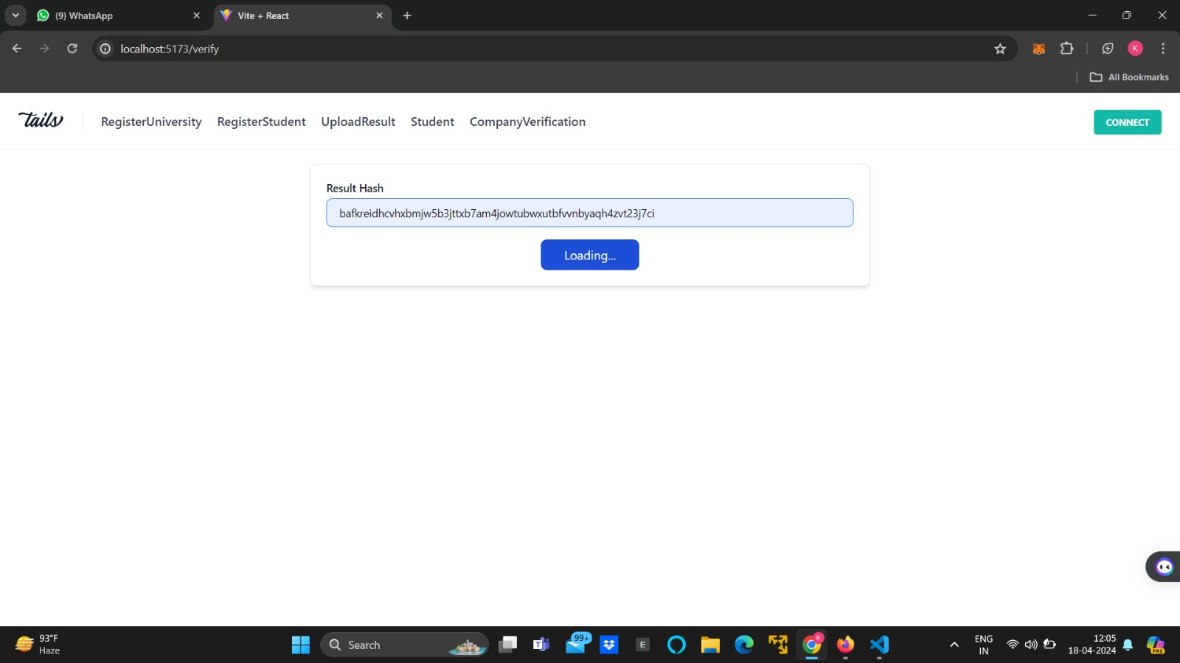

Slide 19
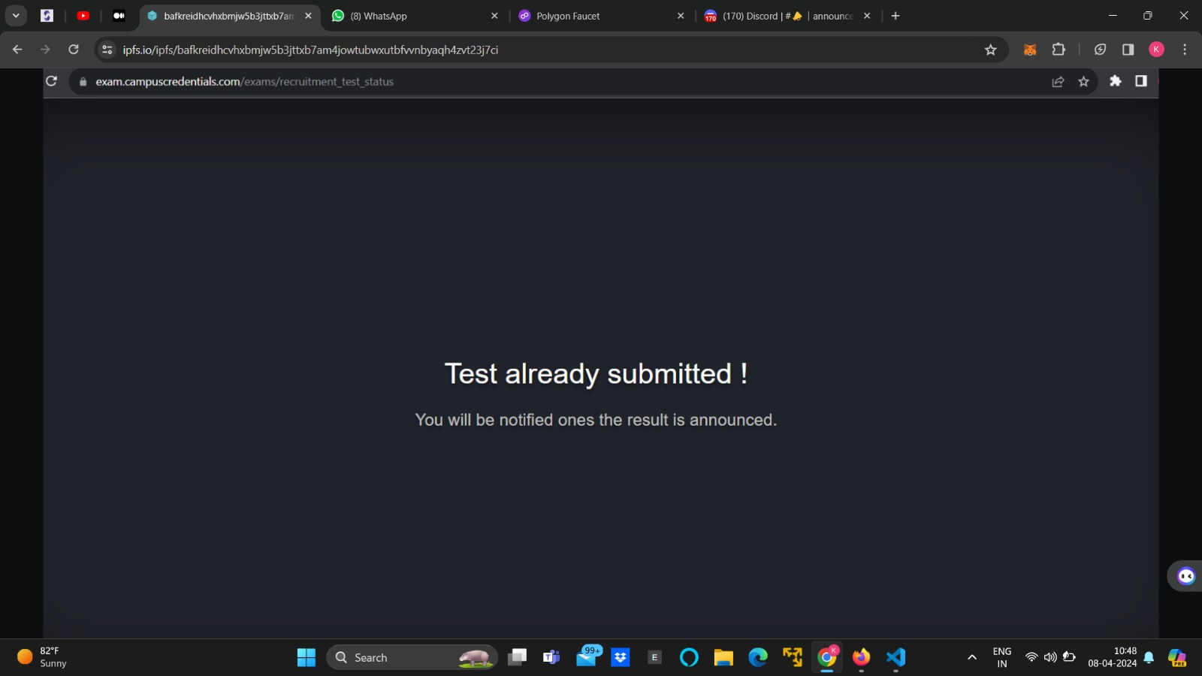

Slide 20
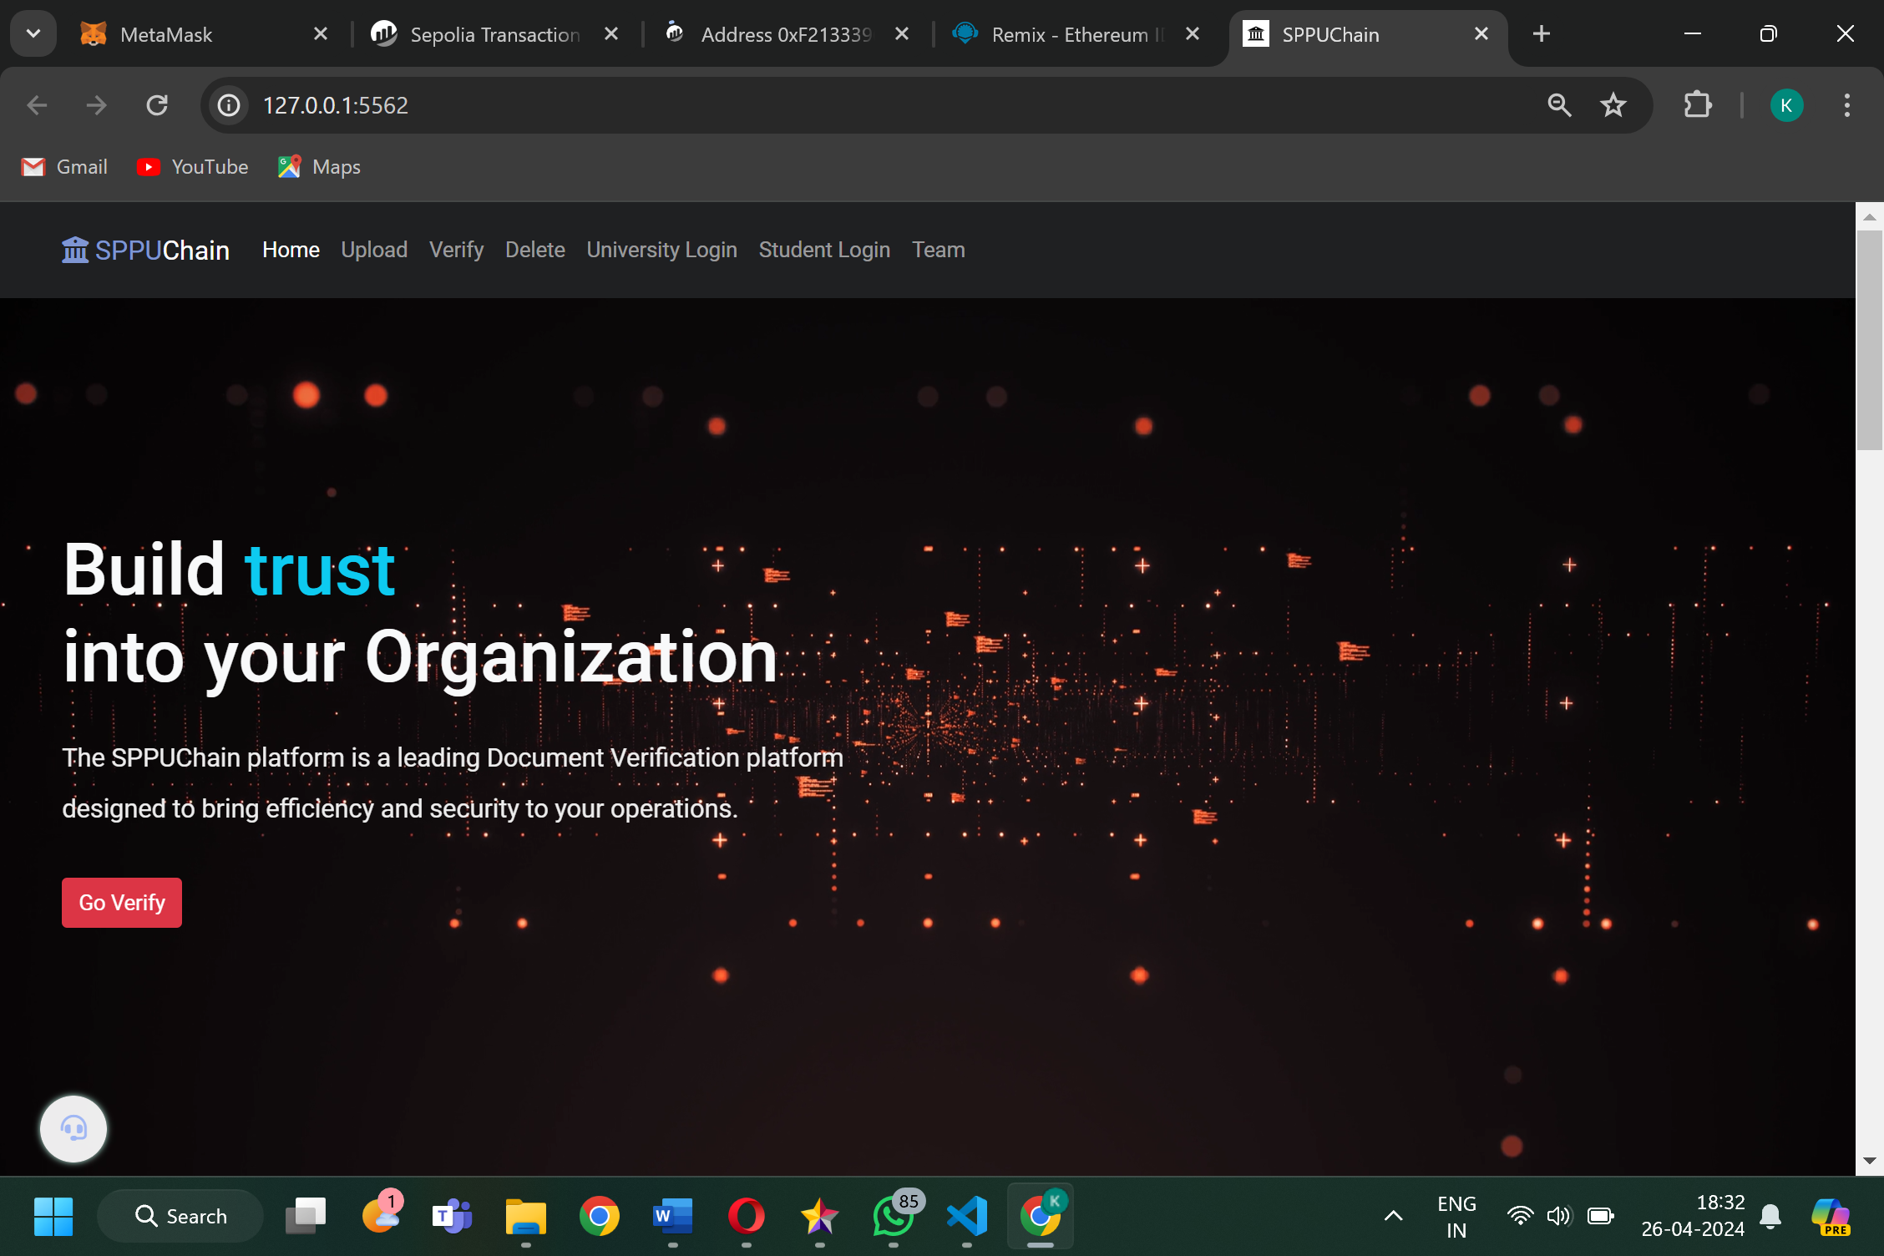
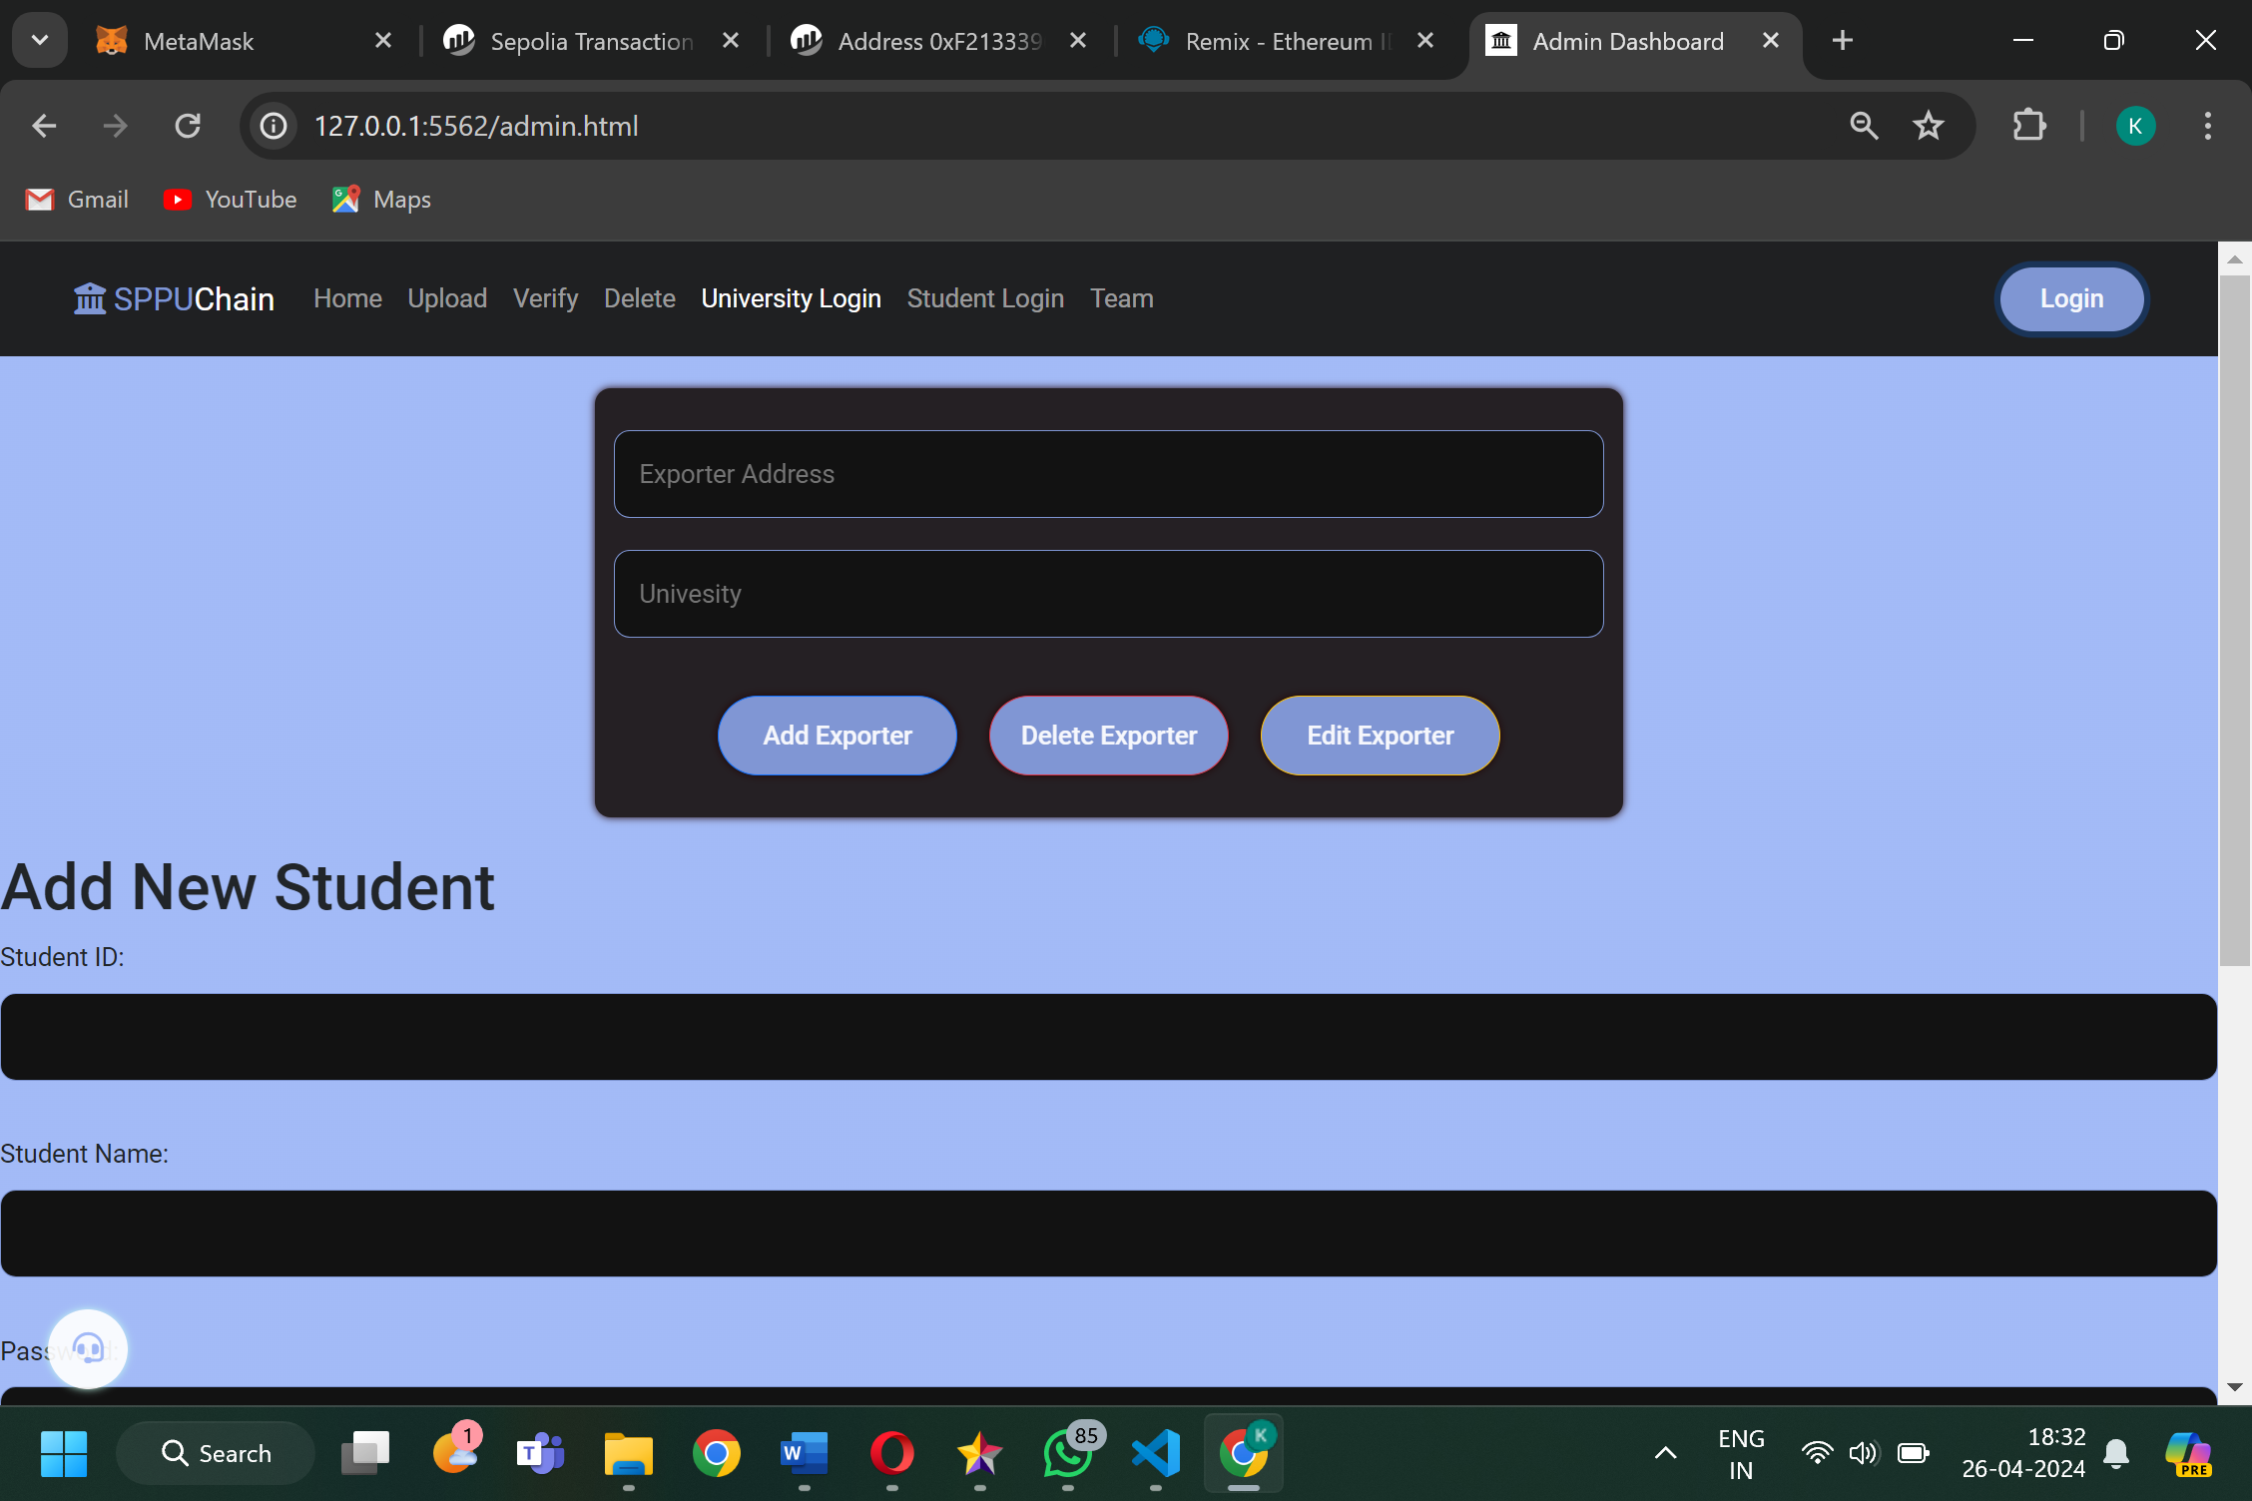
Second Approach to the project:

Slide 21
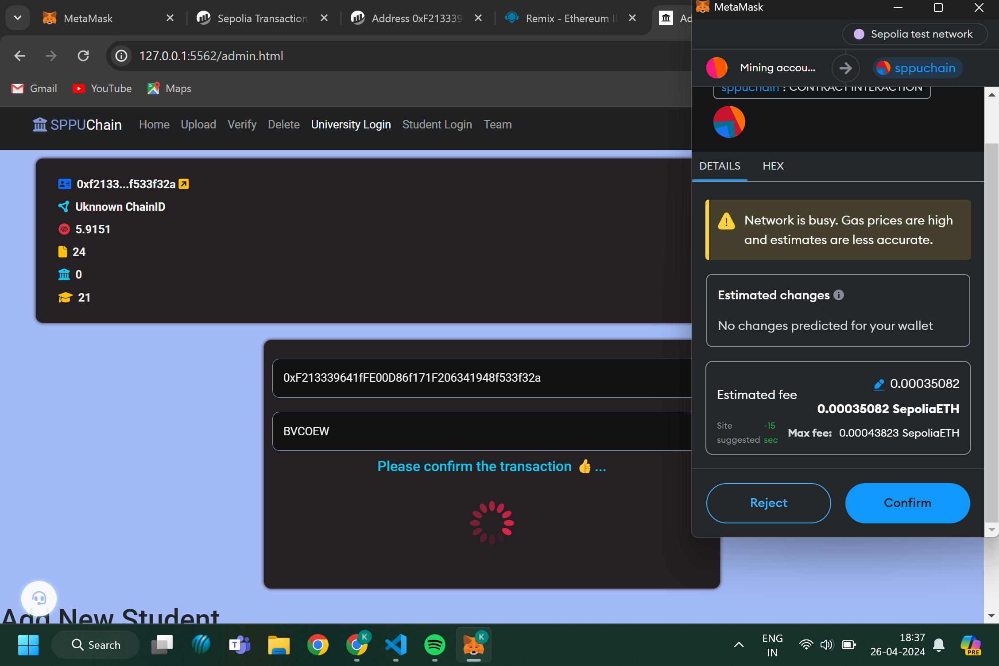
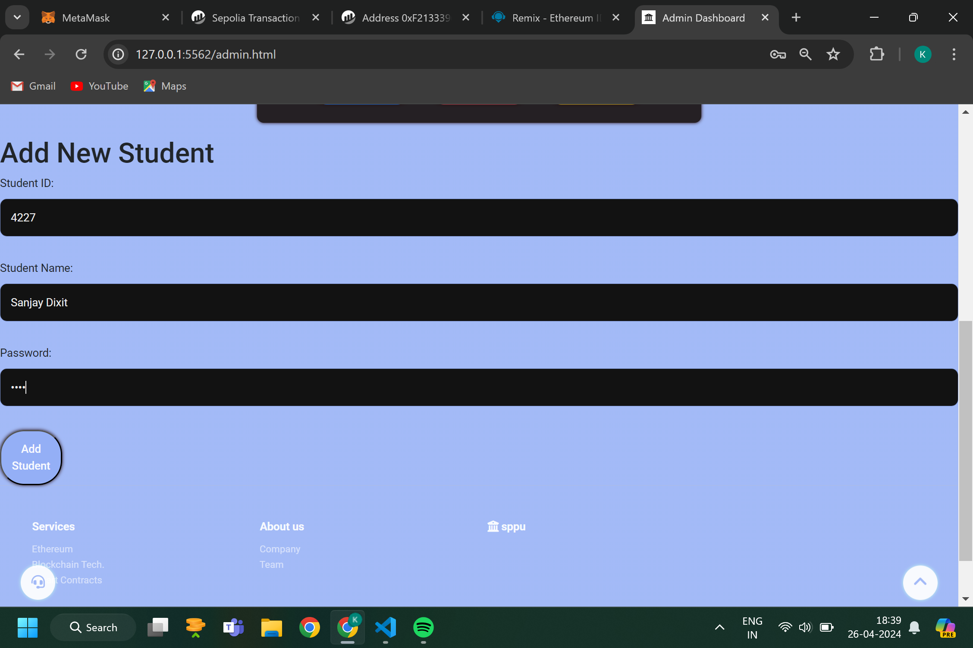

Slide 22
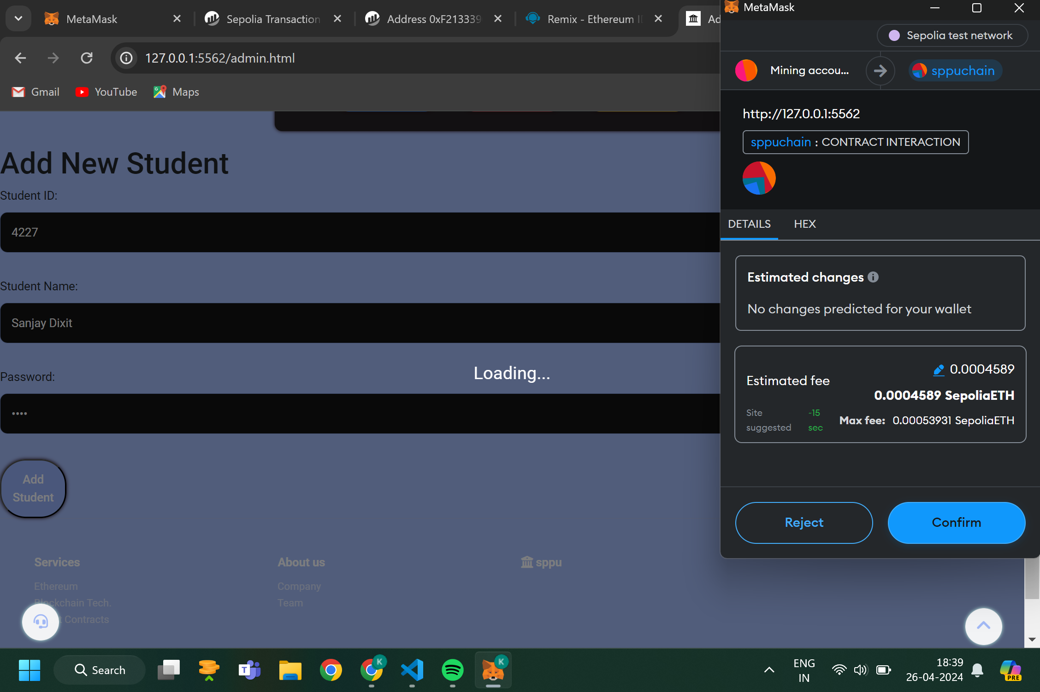
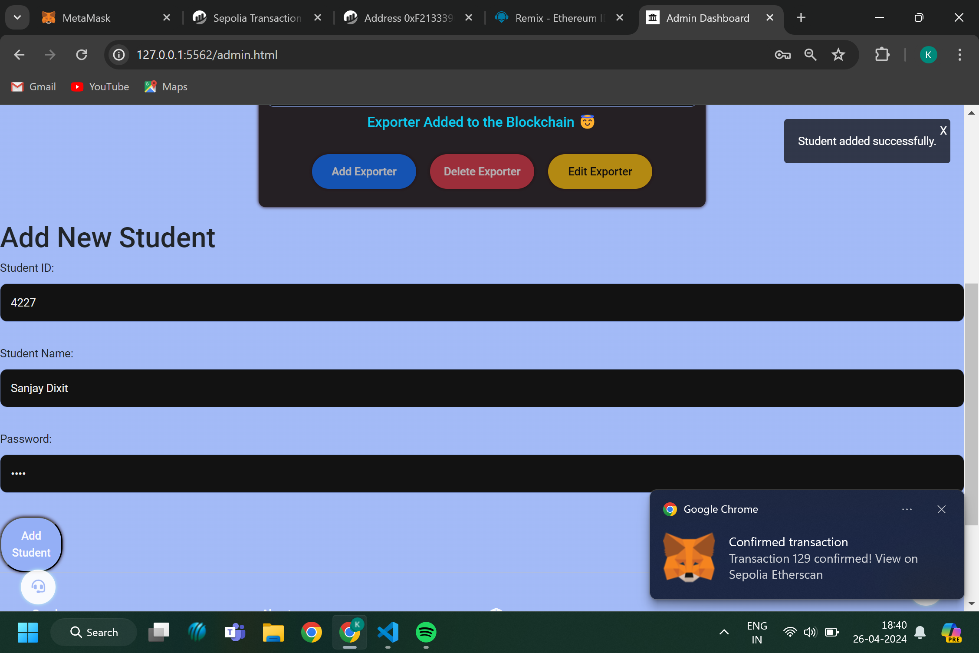

Slide 23
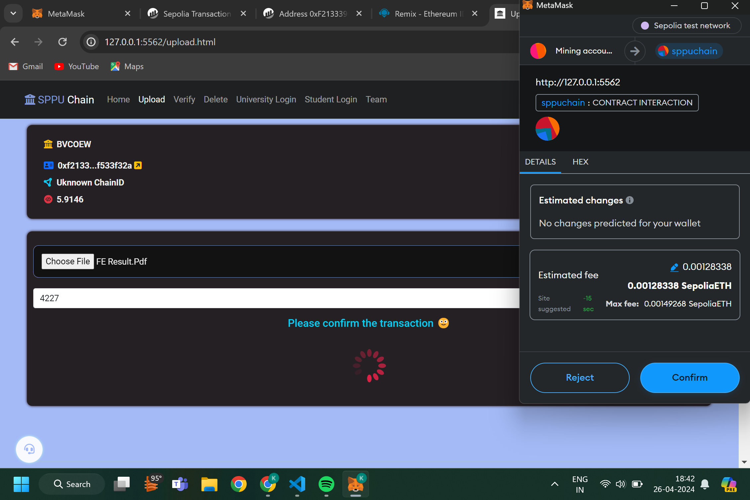
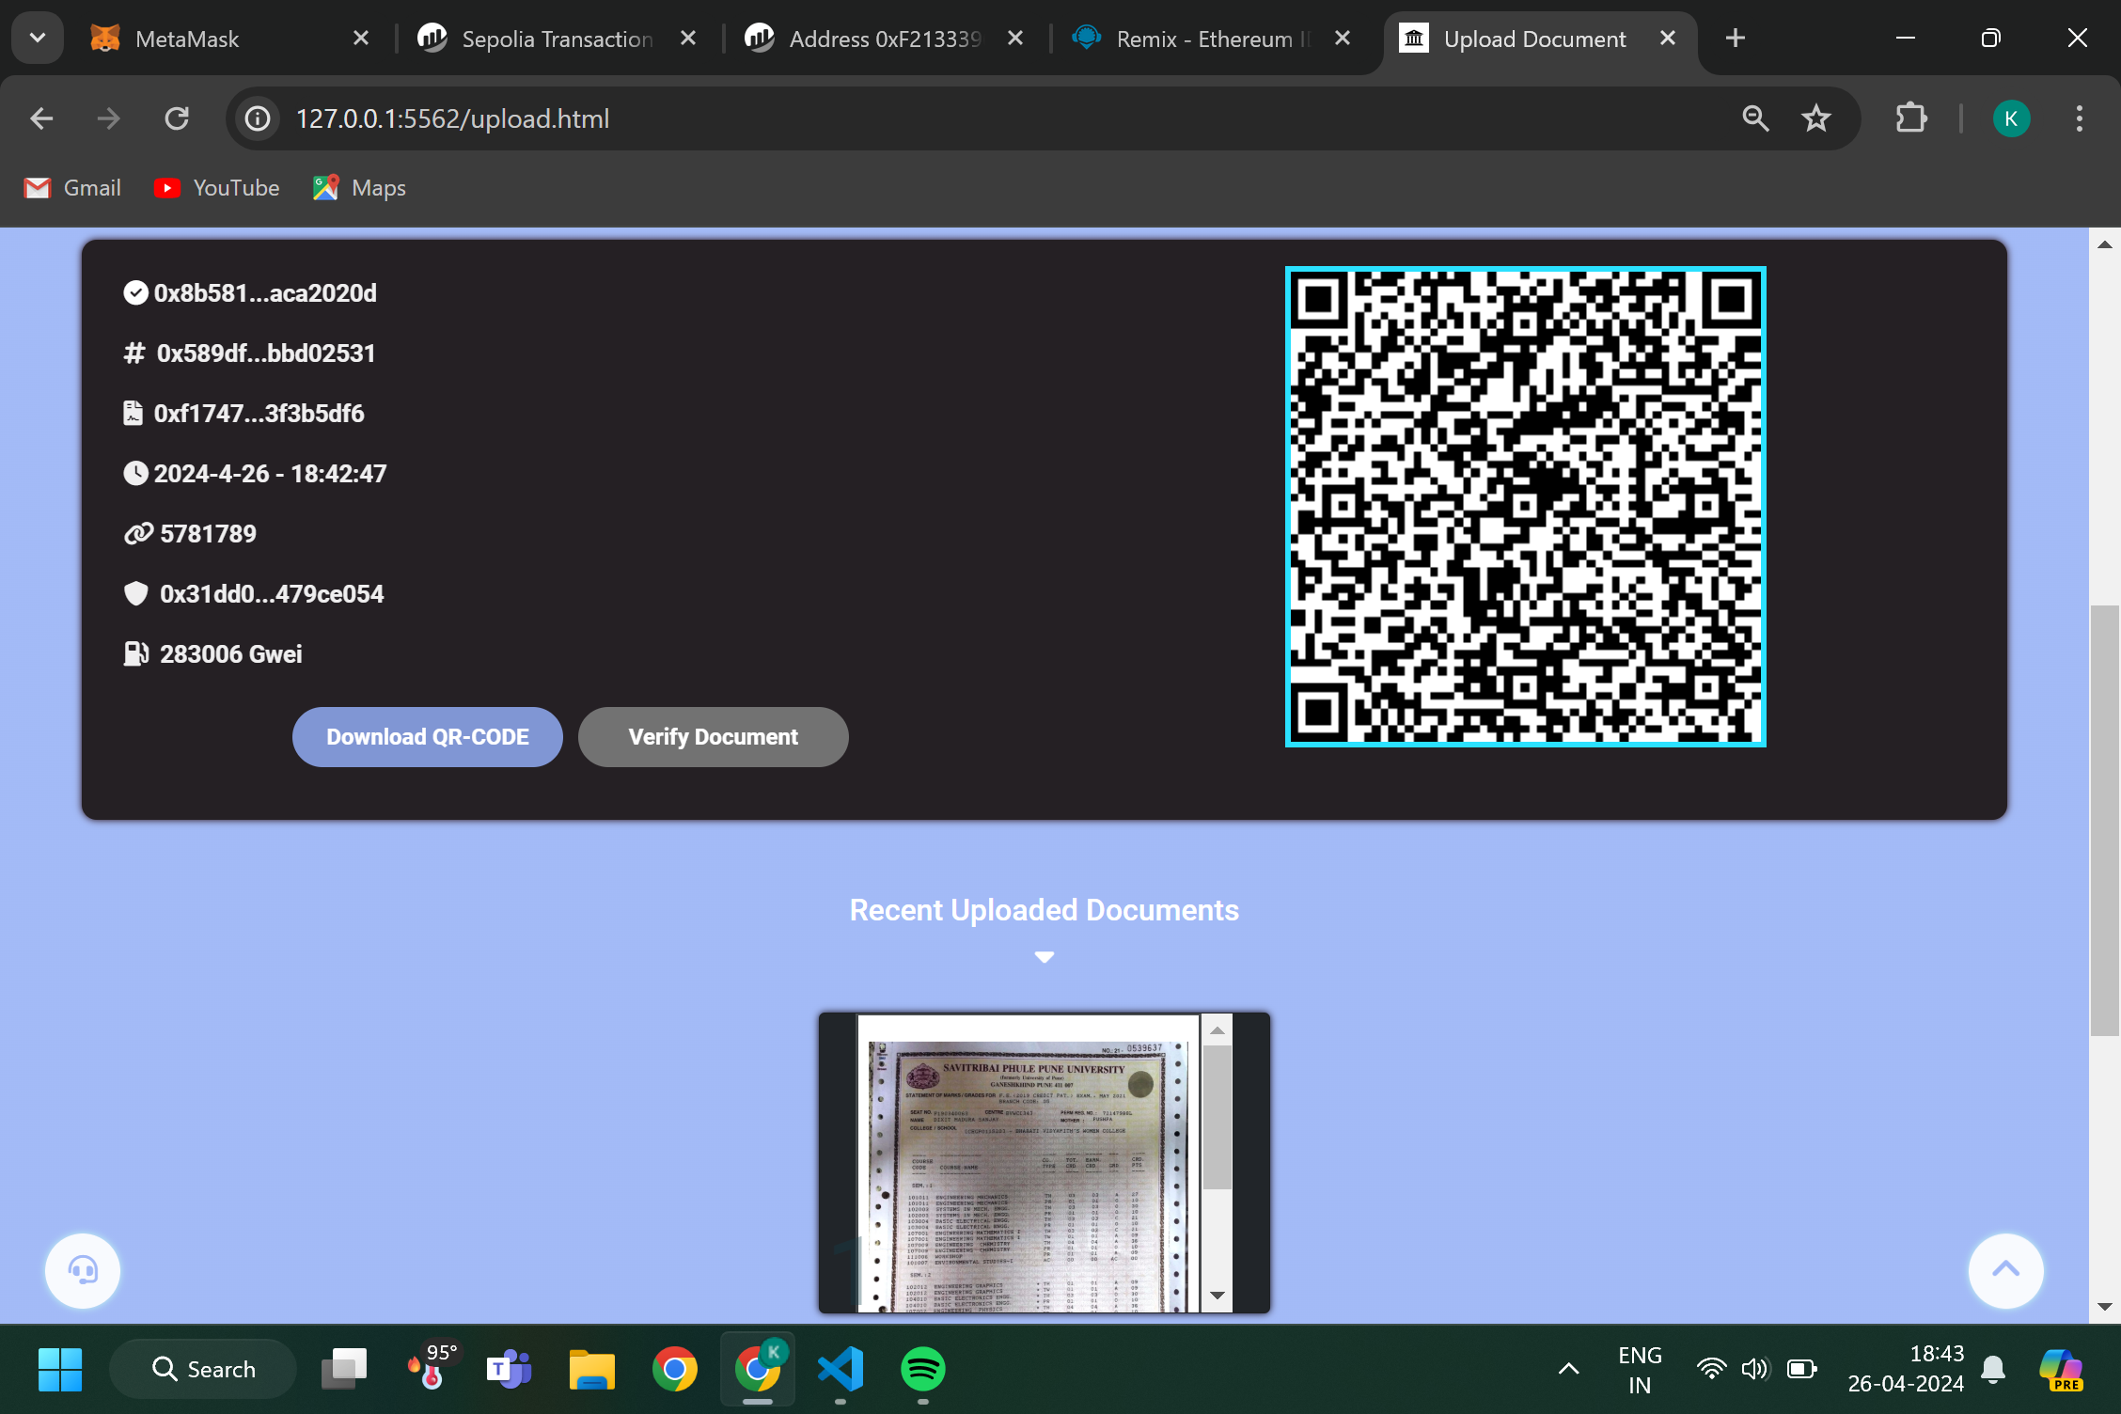

Slide 24
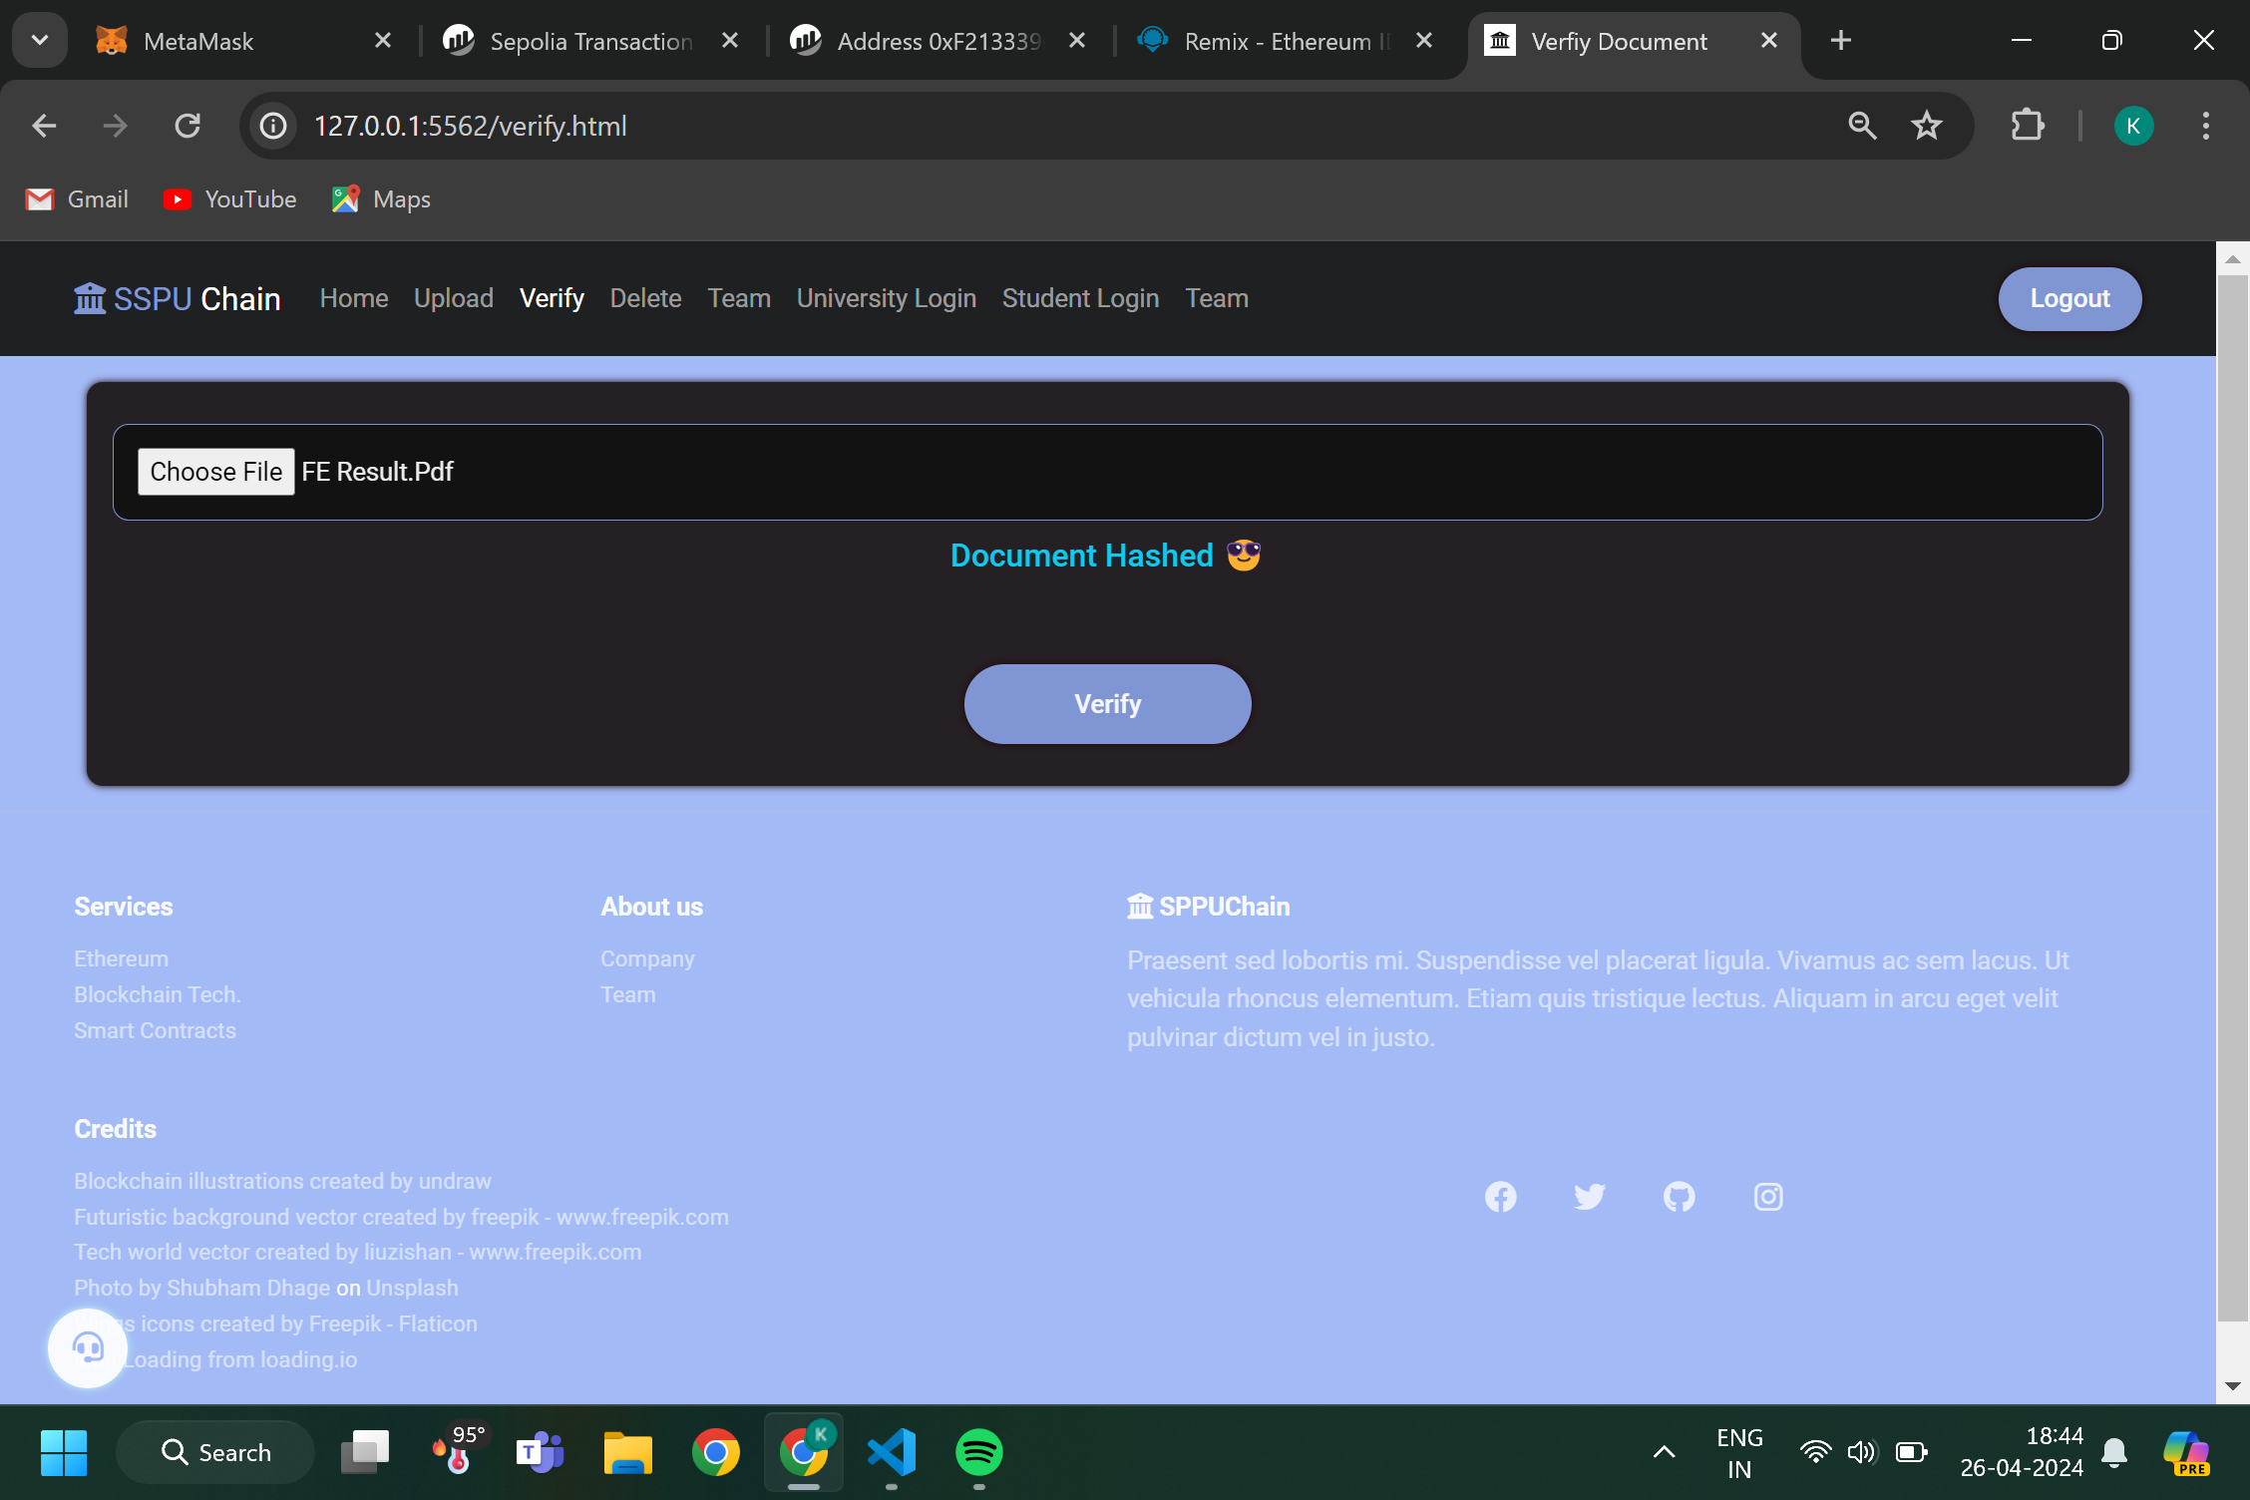
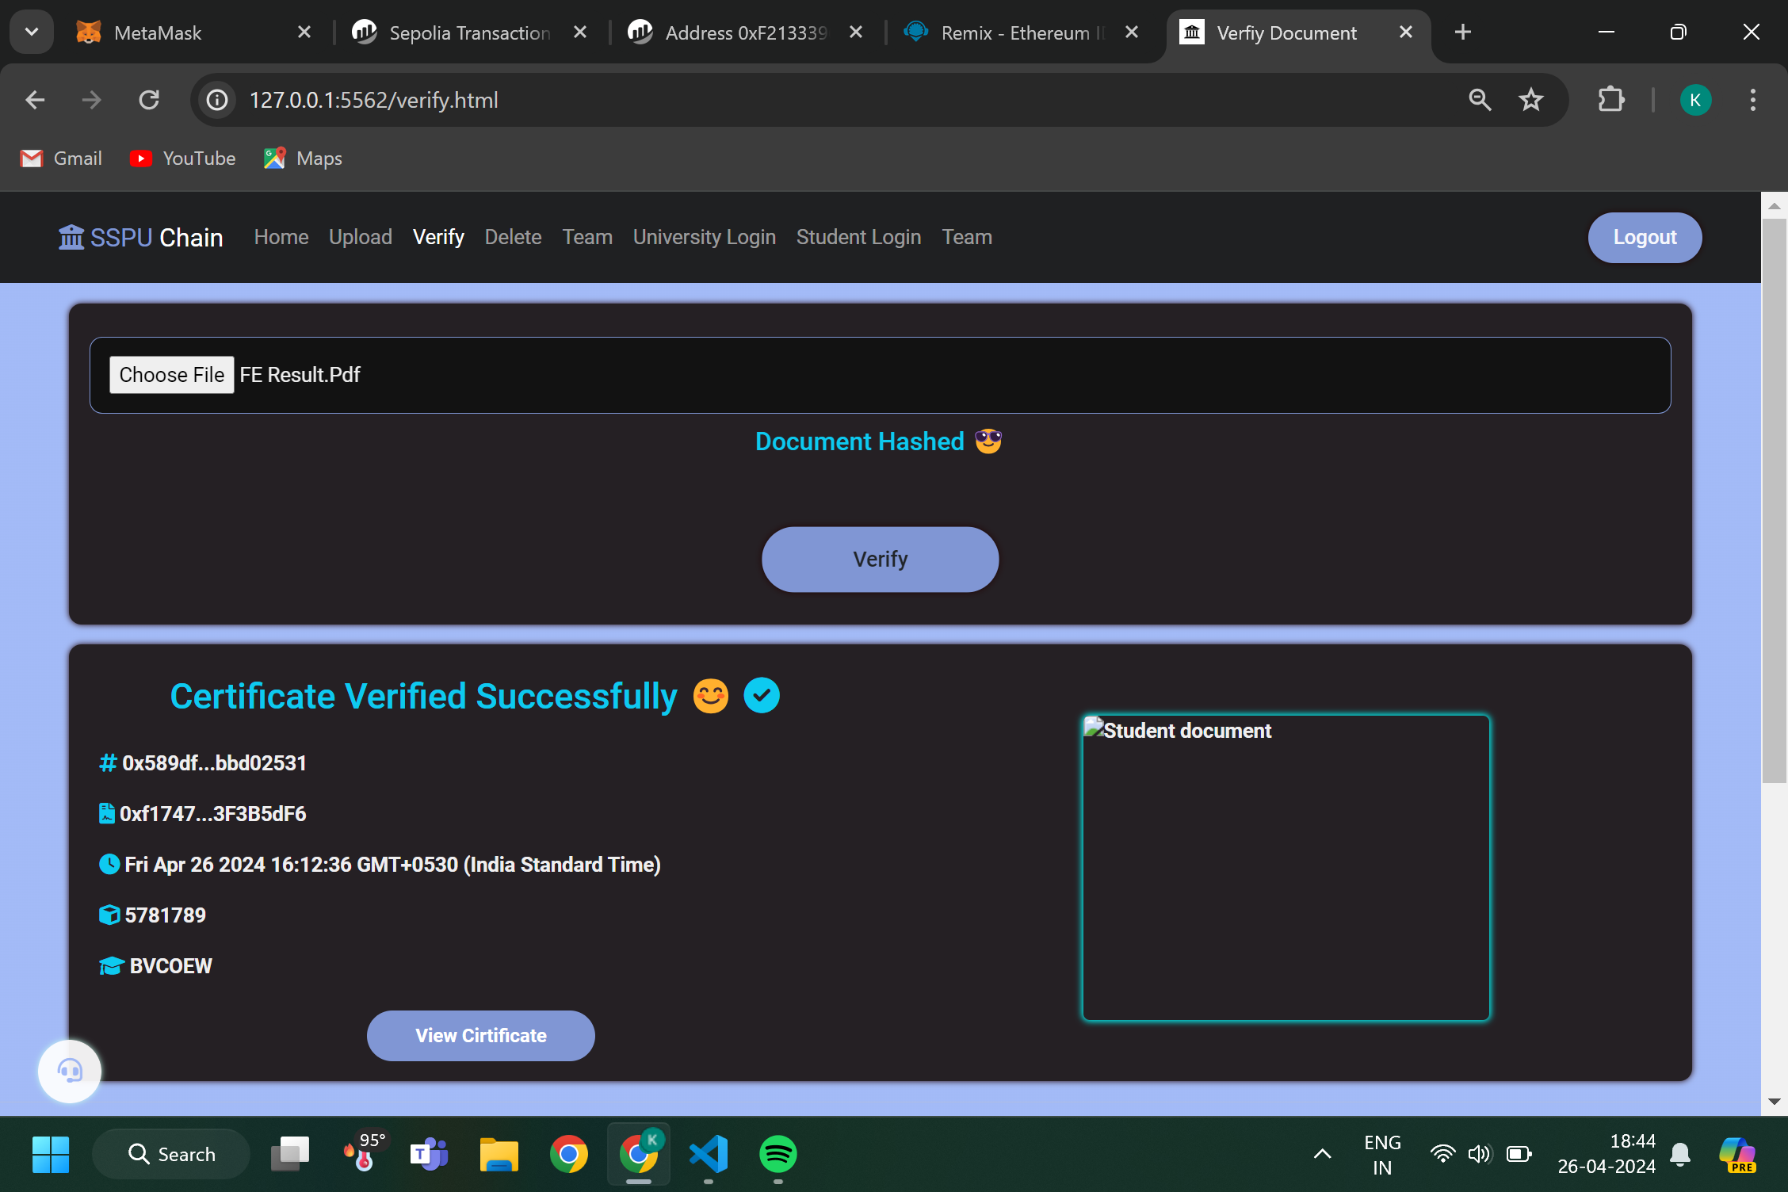

Slide 25
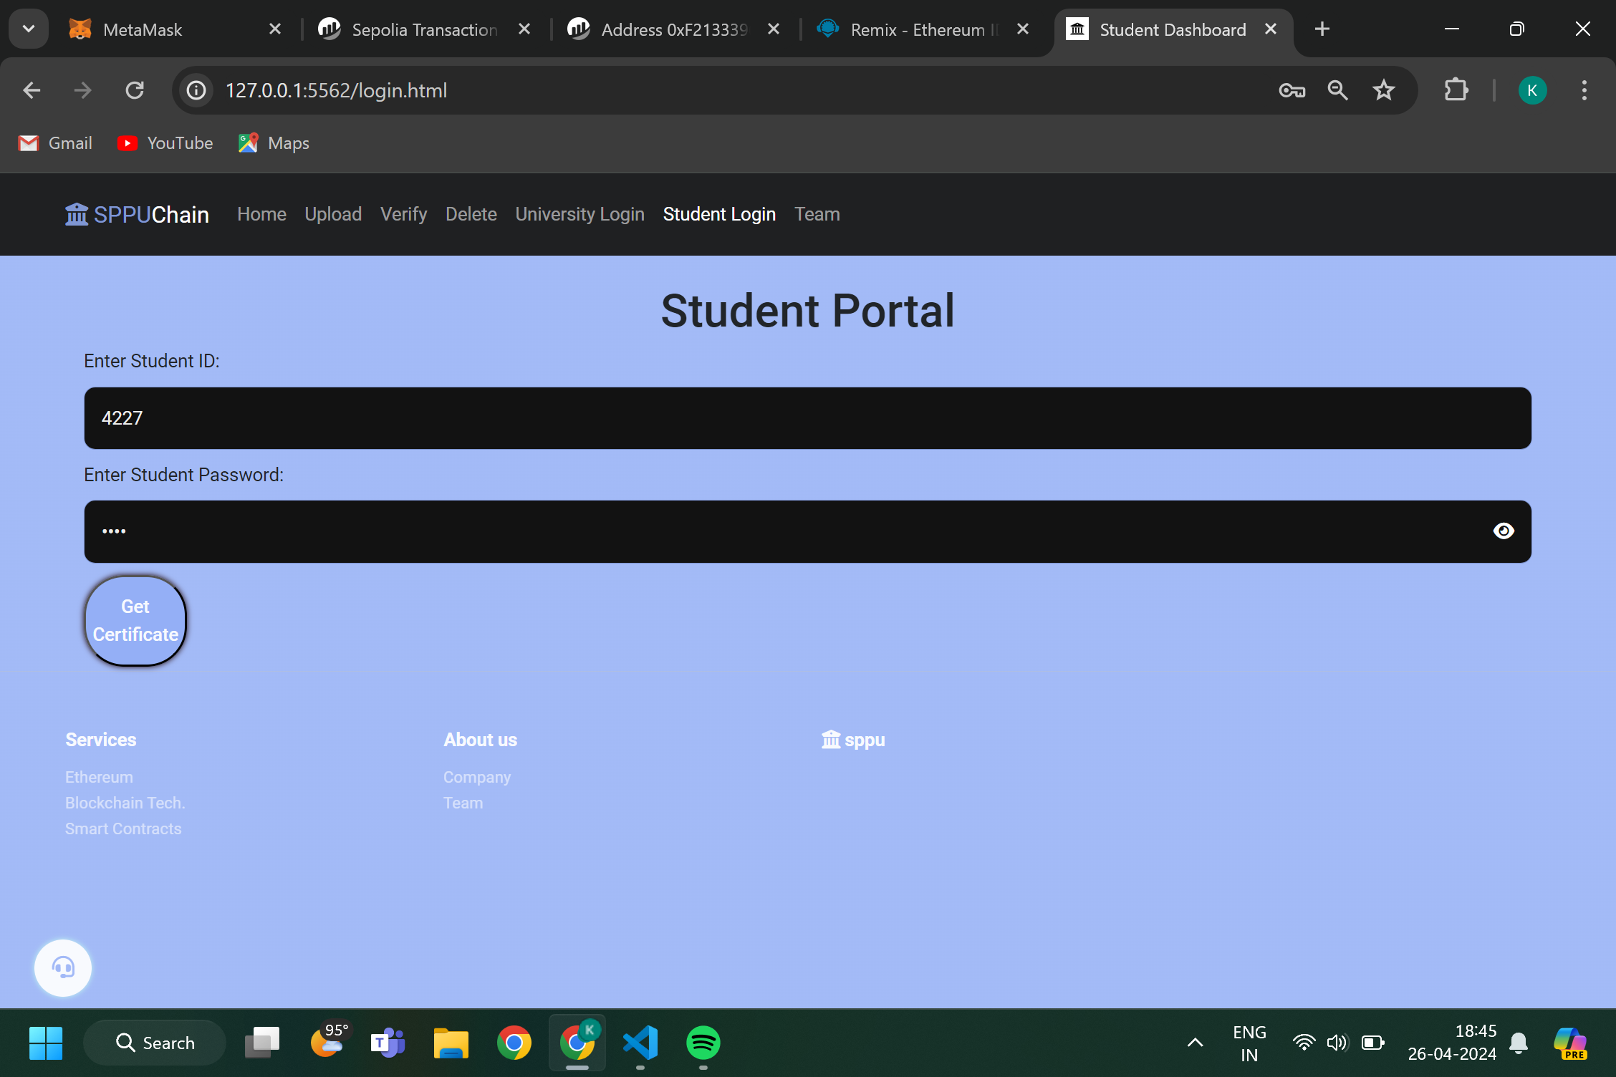
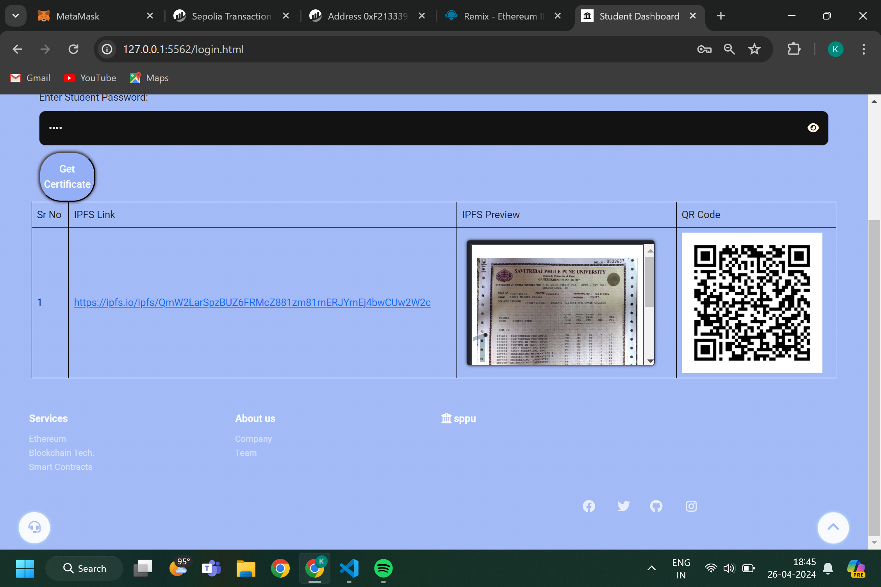

Slide 26
Details of Paper Publication
Name of the conference/journal: International Journal of Creative Research Thoughts (IJCRT ISSN:2320-2882).
Registration ID: 24890
Paper ID: IJCRT2403817
Paper Title: Decentralized Blockchain Based Result Generation And Verification System.
Date of publication: January 2, 2024
Paper: https://ijcrt.org/viewfulltext.php?&p_id=IJCRT24038

Slide 27
Conclusion:
Implementing a blockchain-based certificate verification system using a public blockchain offers secure, transparent, and tamper-resistant validation of certificates. With user-friendly interfaces for issuance and verification, it provides a reliable solution for ensuring the authenticity and integrity of certificates in various applications.
Implemented certificate generation and verification system using public blockchain technology. This system offers temper-proof results, transparent access control, and cryptographic security.

